Slide 1
Face Expression Recognition
Road to Smart Acting
by Bogdan-Daniel Bălănescu

Slide 2
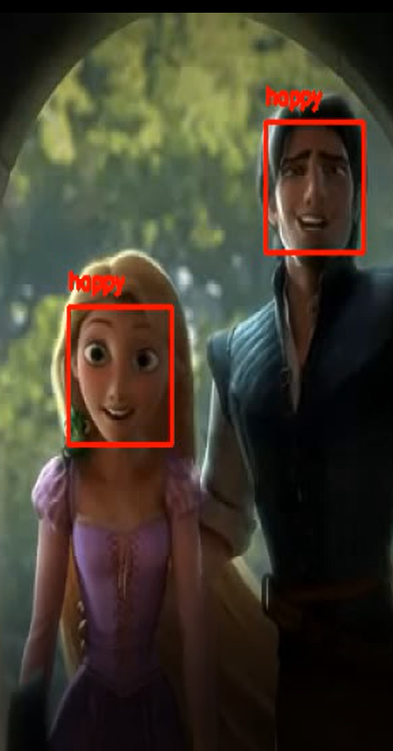
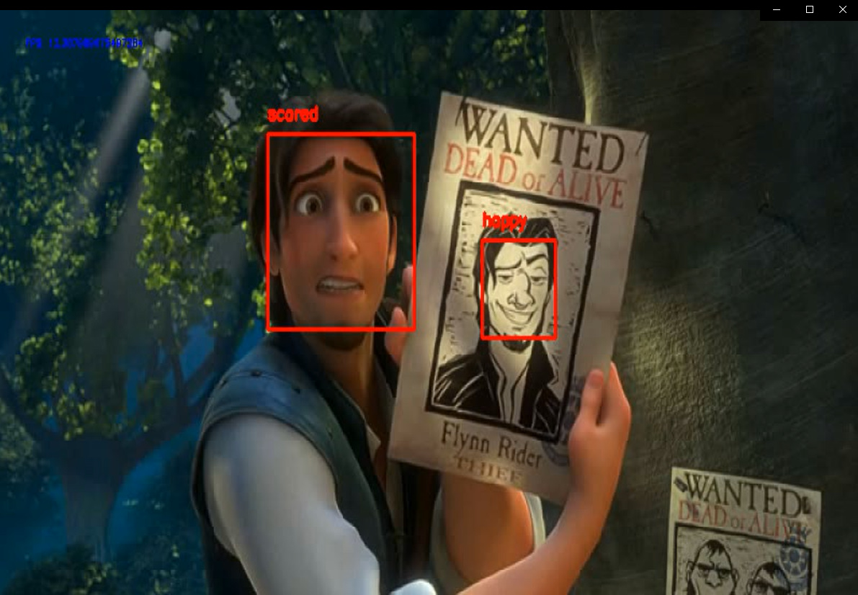
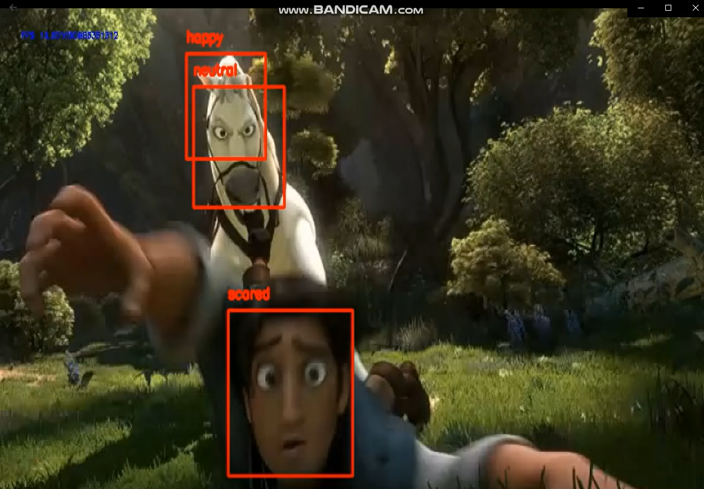
Why train alongside an algorithm?
It’s 24/7 available
It’s free.
It’s catchy!

Slide 3
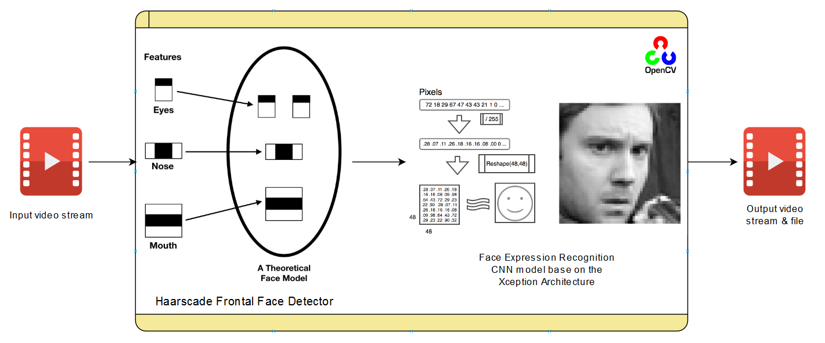
How does it work?

Slide 4

State of the Art (different approaches)
Intelligent Method | 3-NN MLP | SVM Deep-Networks | CNN
Dataset | KDEF (The Karolinska Directed Emotional Faces) | CK+ (Cohn-Kanade Plus) | CK+ (Cohn-Kanade Plus)
Approach Description | Kinect 3D extracts features -> they label emotions | Problems: Illumination variations Subject-dependence | 1. Preprocess (Convolution) 2. Down-sample (Pooling) 3. 2x Parallel Feature Extraction 4. Fully connected layer -> label
Accuracy (%) | 3-NN: [95, 96] MLP: [75, 76] | SVM: [31, 50] Deep-Net.: [92, 96] | CNN: 99
* Pawel Tarnowski, Marcin Kolodziej, Andrzej Majkowski, and Remigiusz J. Rak. Emotion recognition
using facial expressions. 2017.
** Najmeh Samadiani, Guangyan Huang, Borui Cai, Wei Luo, Chi-Hung Chi, Yong Xiang, and Jing
He. A review on automatic facial expression recognition systems assisted by multimodal sensor
data. Multidisciplinary Digital Publishing Institute (MDPI), 2019.
*** Peter Burkert, Felix Trier, Muhammad Zeshan Afzal, Andreas Dengel, and Marcus Liwicki. Dexpression:
Deep convolutional neural network for expression recognition. German Research Center
for Articial Intelligence (DFKI), 2016.

Slide 5
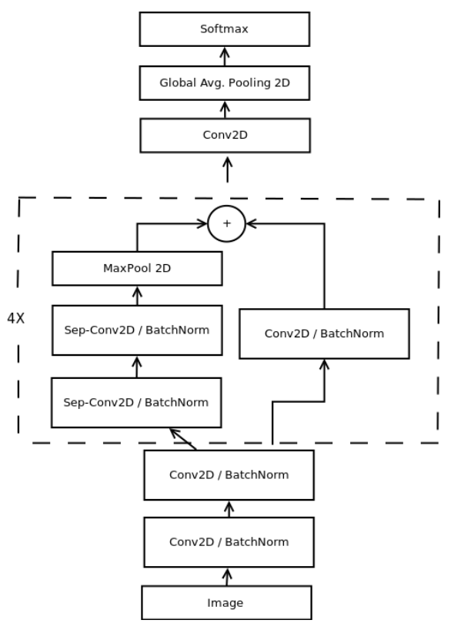
Chosen Model
Intelligent Method | CNN (mini-Xception arch.)
Dataset | FER – 2013
Approach Description | Haar features (48x48) -> emotion labels
Accuracy (%) | CNN: 66
* Octavio Arriaga, Paul G. Ploger, and Matias Valdenegro. Real-time convolutional neural networks
for emotion and gender classication. 2017.

Slide 6
Methodology for improvement
 | Original | Fair 1 | Fair 2 | Change 1 | Change 2 | Change 1 More | Change 2 More | Augment
Dataset Size | FER 35.887 Images | FER 28.709 images | FER 28.709 images | FER 28.709 images | FER 28.709 images | FER 28.709 images | FER 28.709 images | FER 172.254 images
Loss & Learning Rate | Categorical Crossentropy 0.1 | Categorical Crossentropy 0.1 | Categorical Crossentropy 0.01 | Mean Square Error 0.01 | Mean Square Error 0.1 | Squared Hinge Loss 0.1 | Squared Hinge Loss 0.01 | Mean Square Error 0.1
Accuracy (%) | FER: 65 CK+: 76 | FER: 63 CK+: 76 | FER: 63 CK+: 60 | FER: 63 CK+: 69 | FER: 64 CK+: 79 | FER: 63 CK+: 57 | FER: 63 CK+: 58 | FER: 68 CK+: 71

Slide 7
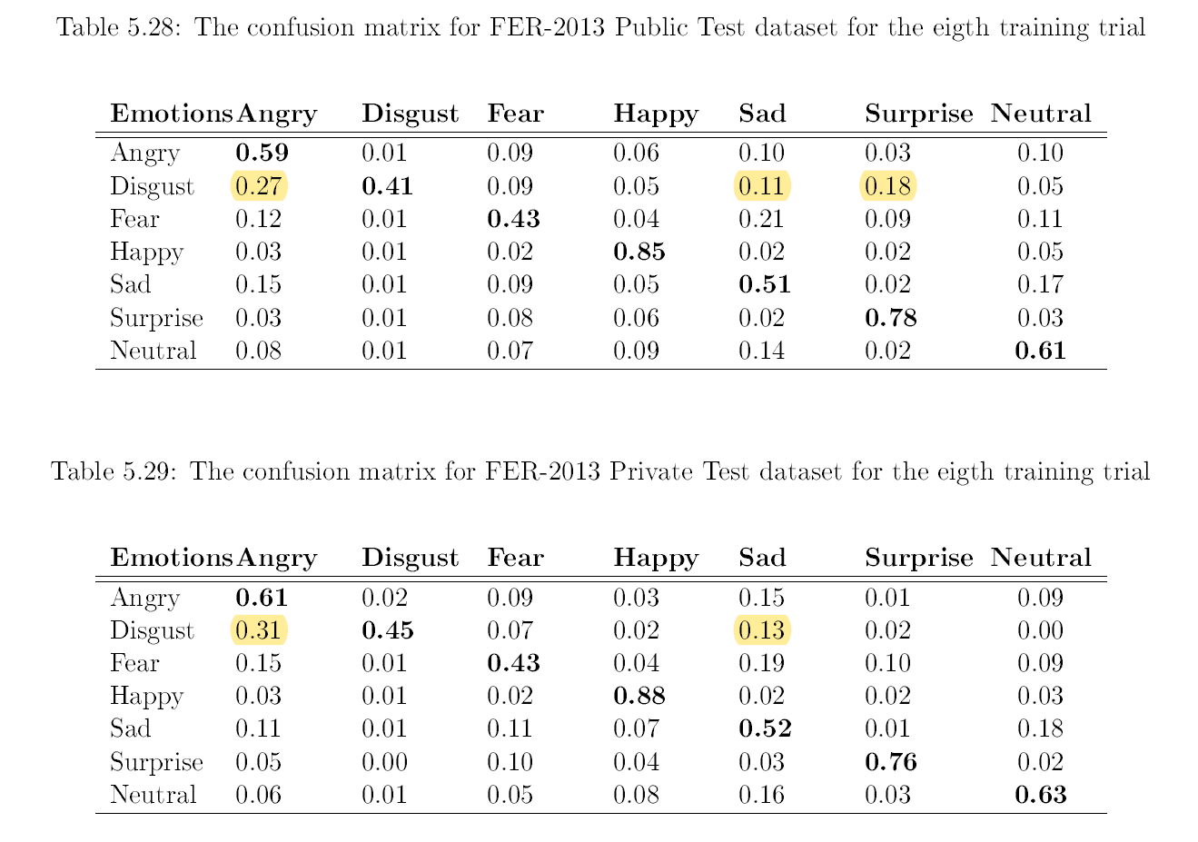
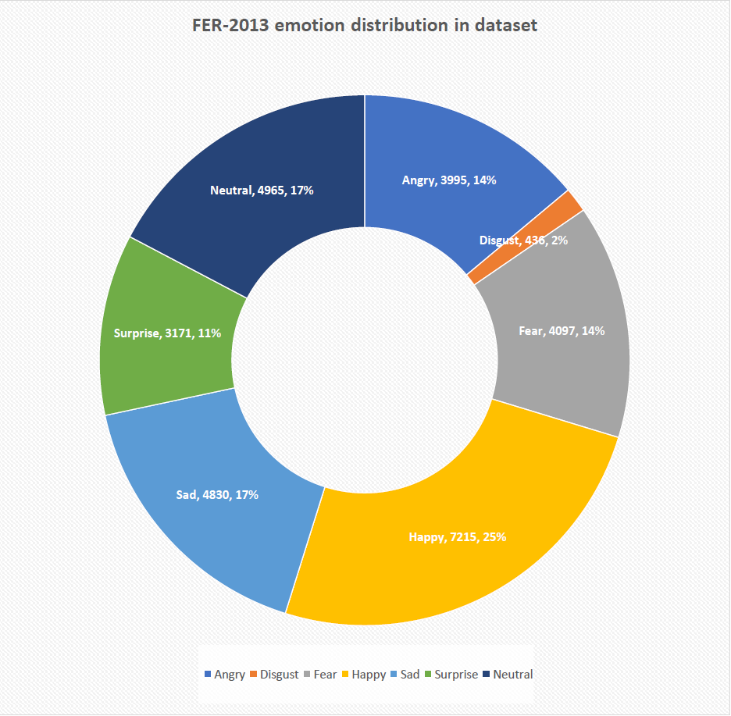
Dealing with Confusion

Slide 8
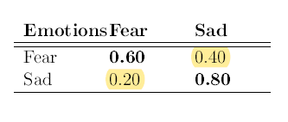
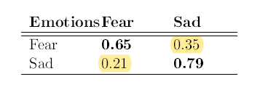
Second Batch
 | Disgust-less 1 | Disgust-less Aug. | Confused again?
Dataset Size | FER 28.273 Images | FER 169.638 images | FER 9.927 Fear and Sad
Loss & Learning Rate | Mean Square Error 0.1 | Mean Square Error 0.1 | Mean Square Error 0.1
Accuracy (%) | FER: 65 CK+: 81 | FER: 68 CK+: 78 | FER: 71 CK+: 73
Confusion Matrix for FER-2013 Public Test dataset
Confusion Matrix for FER-2013 Private Test dataset

Slide 9
State of the Art Comparison
State of the Art | Deep Networks | SVM | CNN | Chosen Model
CK+ Dataset Accuracy (%) | [48, 96] | [31, 50] | [93, 99] | [71, 79]
** Najmeh Samadiani, Guangyan Huang, Borui Cai, Wei Luo, Chi-Hung Chi, Yong Xiang, and Jing
He. A review on automatic facial expression recognition systems assisted by multimodal sensor
data. Multidisciplinary Digital Publishing Institute (MDPI), 2019.
** Najmeh Samadiani, Guangyan Huang, Borui Cai, Wei Luo, Chi-Hung Chi, Yong Xiang, and Jing
He. A review on automatic facial expression recognition systems assisted by multimodal sensor
data. Multidisciplinary Digital Publishing Institute (MDPI), 2019.
*** Peter Burkert, Felix Trier, Muhammad Zeshan Afzal, Andreas Dengel, and Marcus Liwicki. Dexpression:
Deep convolutional neural network for expression recognition. German Research Center
for Articial Intelligence (DFKI), 2016.
Octavio Arriaga, Paul G. Ploger, and Matias Valdenegro. Real-time convolutional neural networks
for emotion and gender classication. 2017.

Slide 10
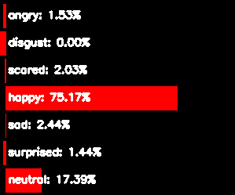
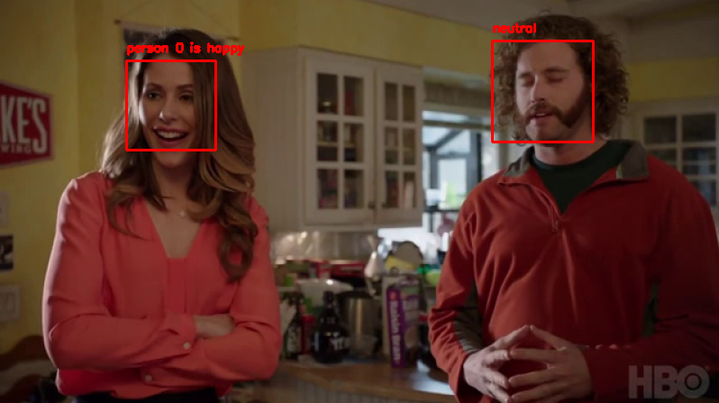
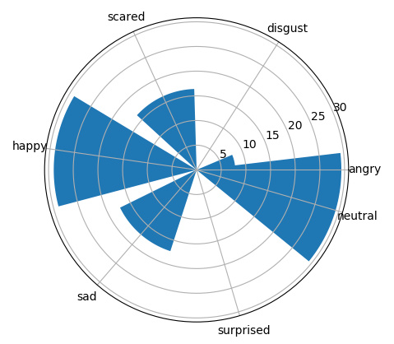
Acting Mirror

Slide 11
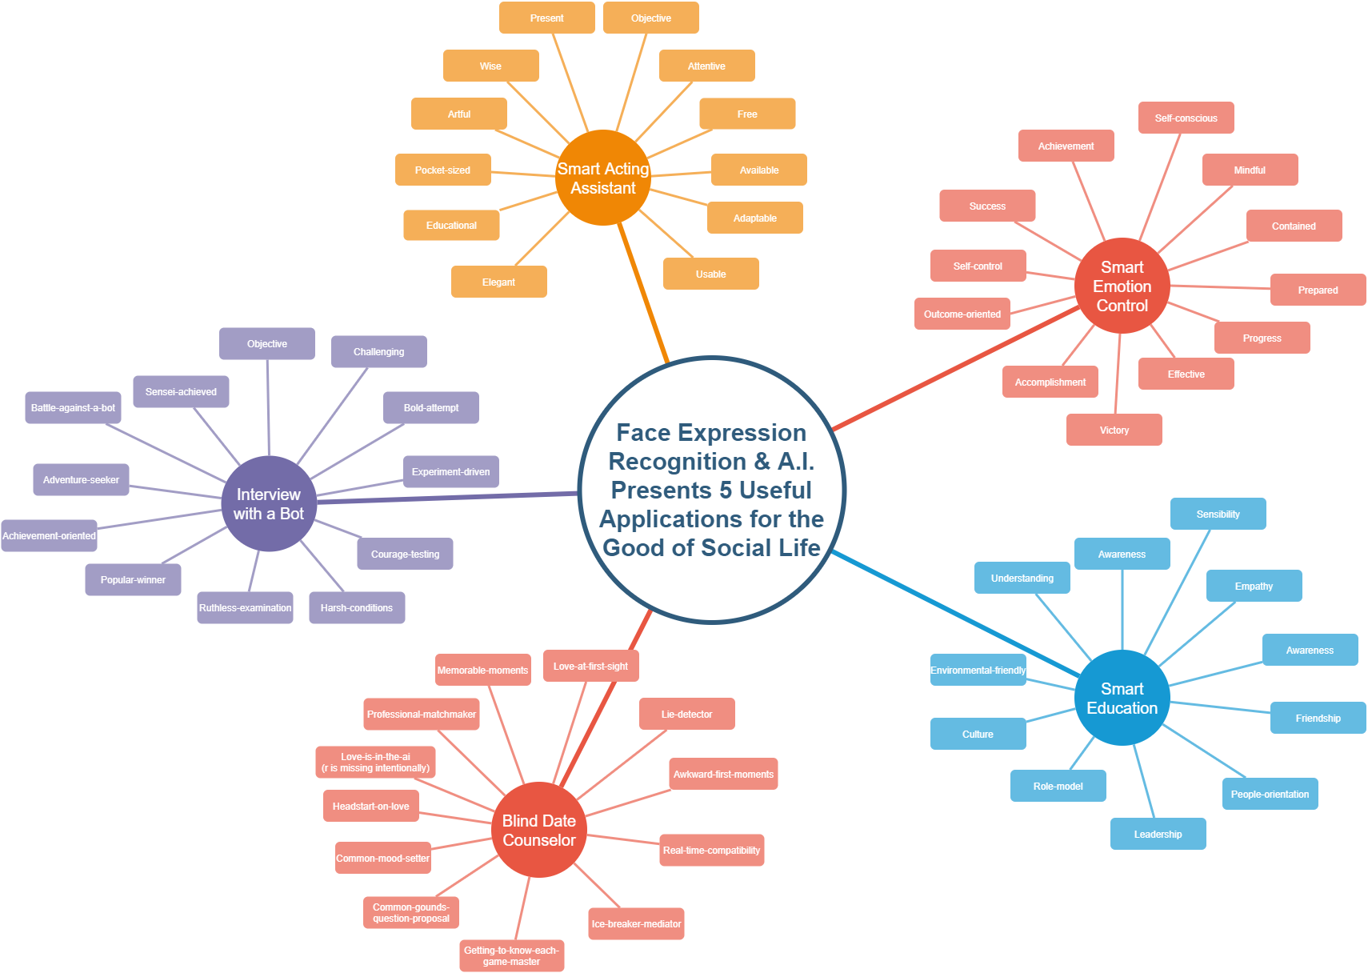

Slide 12
Conclusions
What we have learned:
A.I. can be fun once you get the hang of it!
It’s interesting to extend the usage of your application (e.g. from humans to animations)
Brainstorming makes for interesting mind-maps
Start with the confusion matrix! (it helps in choosing a good dataset)
Future work
Better datasets (work could be done to validate existing datasets)
Ethical discussions (should algorithms like this be used in real life scenarios?)
Acting Mirror Improvements
Add new features (reading from scripts, give audio feedback, give performance tips)

Slide 13
Thanks for listening!
App demo
Q&A

Slide 14
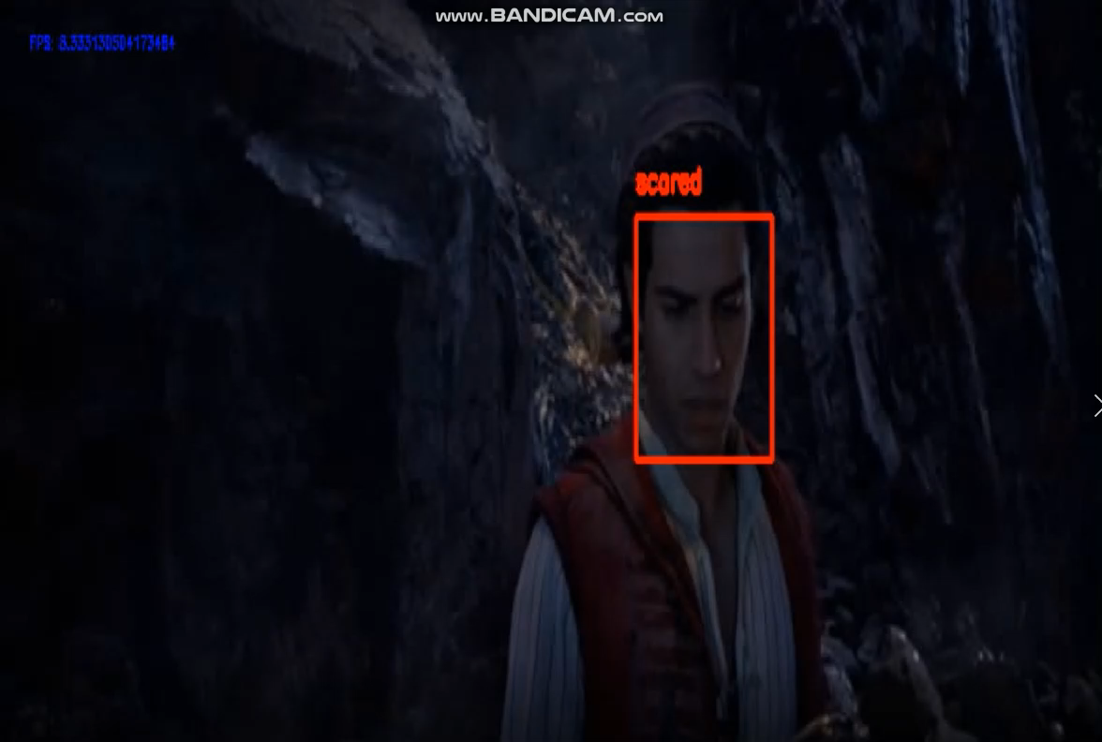
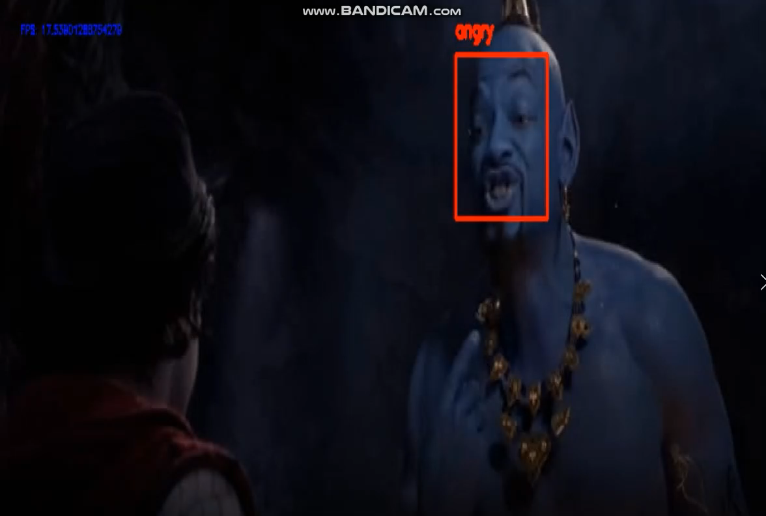
Aladdin meets Genie
Looking at the Lamp
“Genie! Not Giant!”

Slide 15
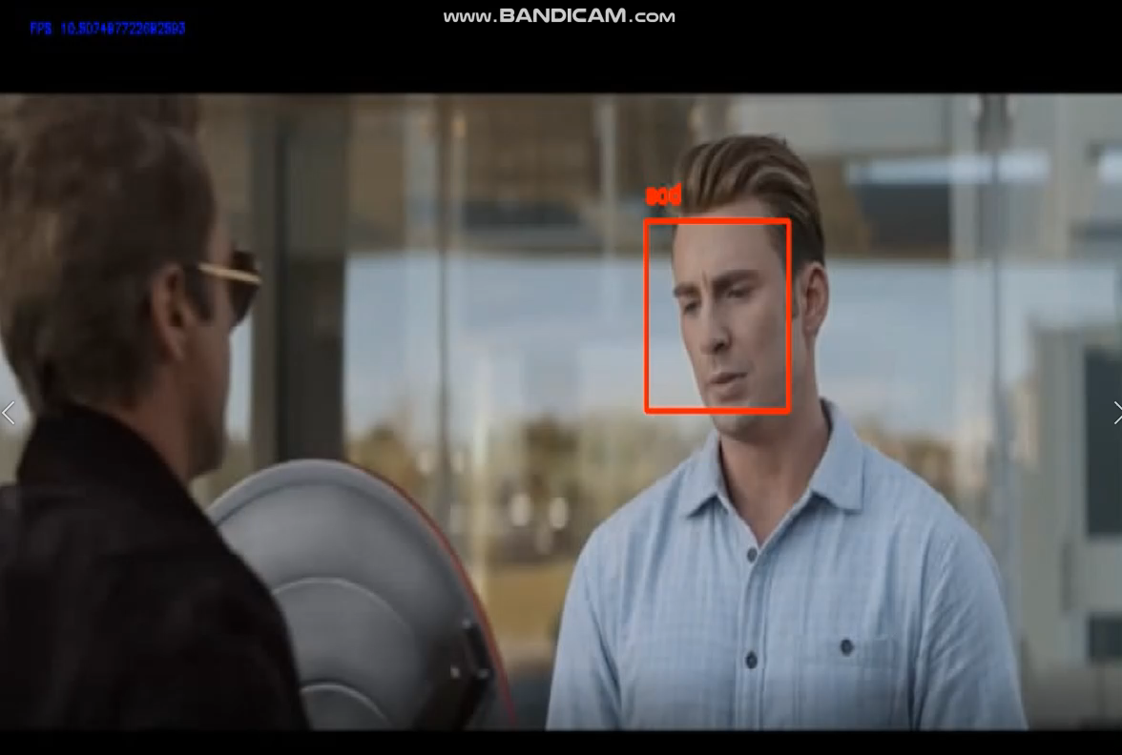
Captain America getting his Shield back!

Slide 16
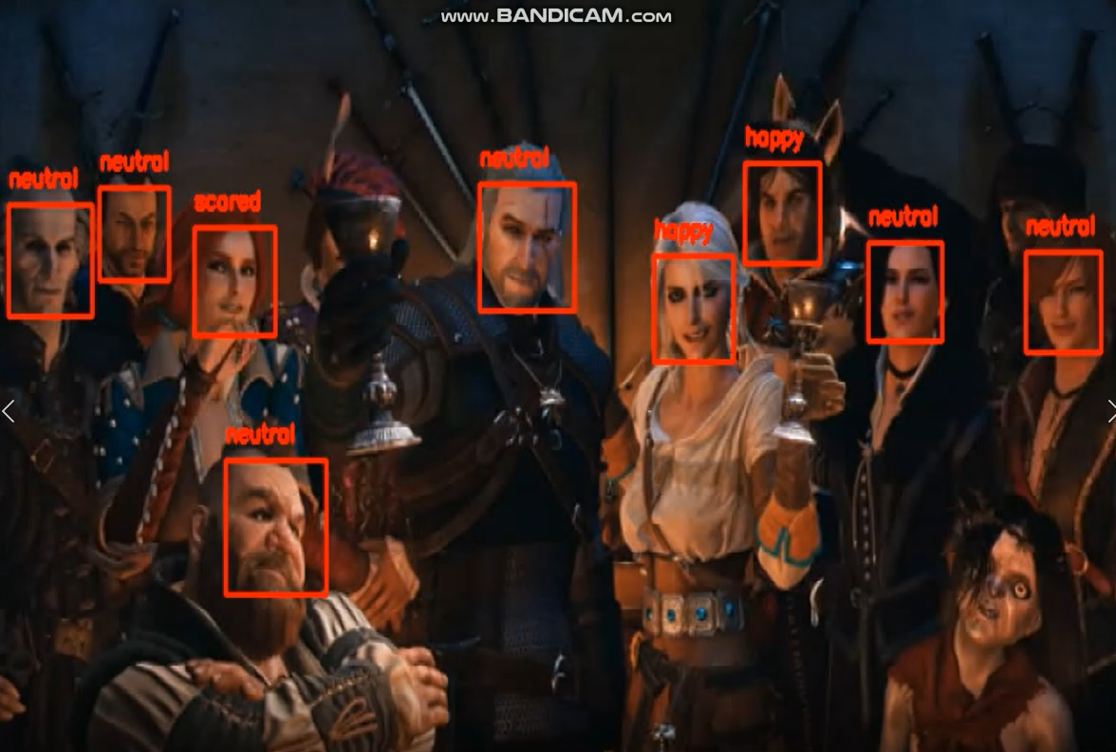
Witcher 3 10th Year Anniversary

Slide 17
Thanks again!
Q&A

